Slide 1
Requirements
Basic Understanding of Folder and File Structures
Basic Understanding of Eclipse IDE, XML.
Eclipse Installed and Running
JDK 1.8 installed and running. (Double Check)

Slide 2
Suffer The Pain Of IDE Dependent Project Structure

Slide 3
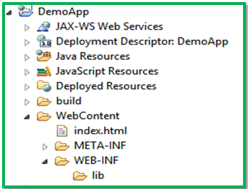
Eclipse IDE Project Structure

Slide 4
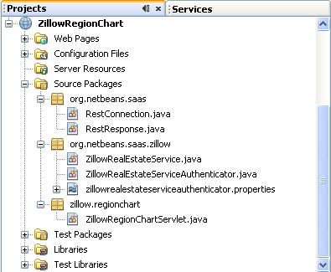
NetBeans IDE Project Structure

Slide 5
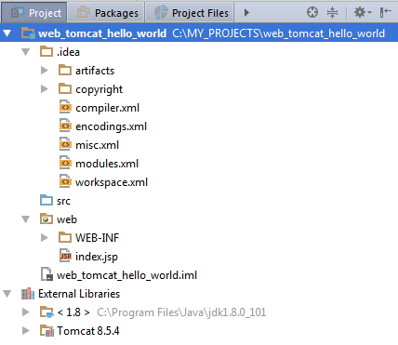
IntelliJ IDE Project Structure

